Slide 1

PIZZAHUT PROJECT - SQL
Analyzing Sales and Operations with SQL Queries

Slide 2
About Project
Project Overview
The SQL project focuses on analyzing Pizza Hut's data to gain insights into sales and operations.
Utilizing a variety of SQL queries, the project aims to identify key business metrics and trends. The
data includes customer details, orders, order details, product information, and employee
records.
Objectives
Customer Segmentation: Identify top customers based on the number of orders placed.
Sales Analysis: Calculate total sales per product.
Monthly Revenue: Determine the total revenue generated each month.
Employee Performance: Evaluate employee performance based on the number of order handled.
Popular Products: Identify the most popular products based on sales quantity.
Revenue by Customer Region: Analyze revenue distribution across different customer
regions.

Slide 3
QUERIES SOLVED
Retrieve the total number of orders placed.
Calculate the total revenue generated from pizza sales.
Identify the highest-priced pizza.
Identify the most common pizza size ordered.
List the top 5 most ordered pizza types along with their quantities.
Join the necessary tables to find the total quantity of each pizza category ordered.
Determine the distribution of orders by hour of the day.
Join relevant tables to find the category-wise distribution of pizzas.
Group the orders by date and calculate the average number of pizzas ordered per day.
Determine the top 3 most ordered pizza types based on revenue.
Calculate the percentage contribution of each pizza type to total revenue.
Analyze the cumulative revenue generated over time.
Determine the top 3 most ordered pizza types based on revenue for each pizza category.

Slide 4


Retrieve the total number of orders placed.

Slide 5
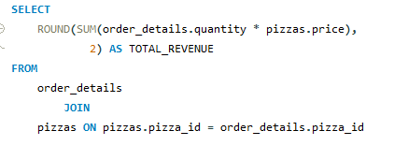

Calculate the total revenue generated from pizza sales.

Slide 6
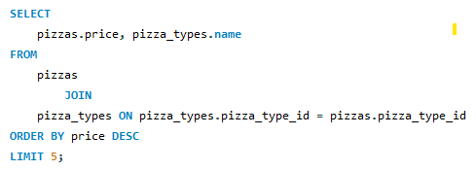
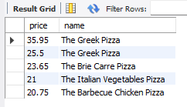
Identify the highest-priced pizza.

Slide 7
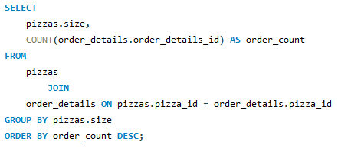
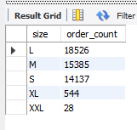
Identify the most common pizza size ordered.

Slide 8
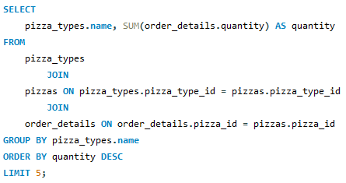
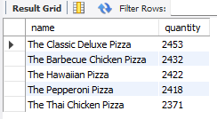
List the top 5 most ordered pizza types along with their quantities.

Slide 9
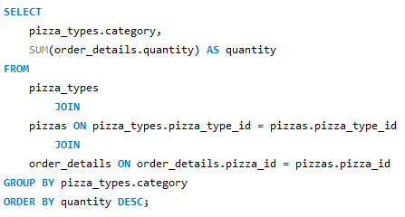
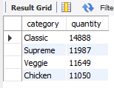
Join the necessary tables to find the total quantity of each pizza category ordered.

Slide 10
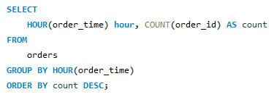
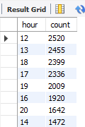
Determine the distribution of orders by hour of the day.

Slide 11
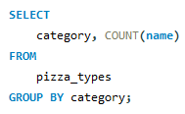
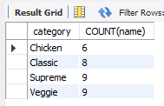
Join relevant tables to find the category-wise distribution of pizzas.

Slide 12
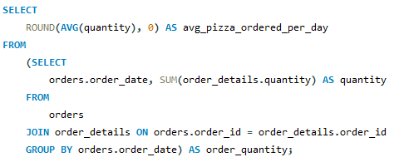

Group the orders by date and calculate the average number of pizzas ordered per day.

Slide 13
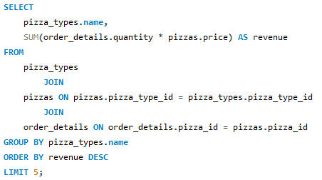
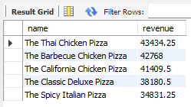
Determine the top 3 most ordered pizza types based on revenue.

Slide 14
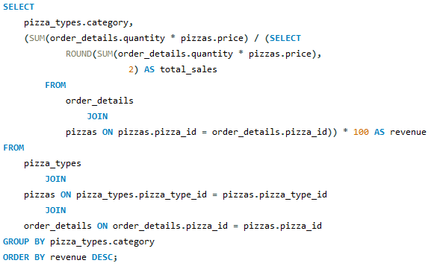
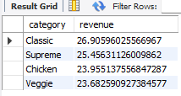
Calculate the percentage contribution of each pizza type to total revenue.

Slide 15
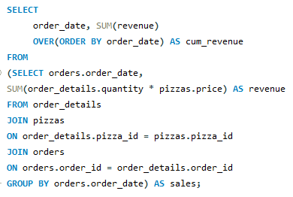
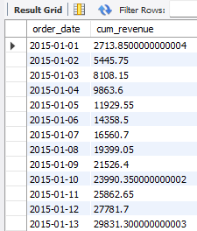
Analyze the cumulative revenue generated over time.

Slide 16
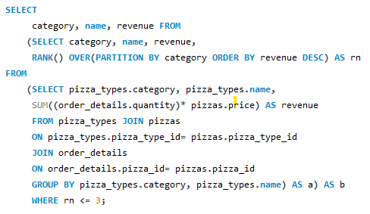
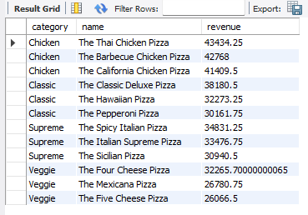
Determine the top 3 most ordered pizza types based on revenue for each pizza category.

Slide 17
THANK YOU
Made by : Rishav Raj

